Slide 1
LIBRARY MANAGEMENT SYSTEM
PRINCIPLE OF PROGRAMMING PROJECT (PPL) ECS : 553
BY GULSHAN RAJDEV

Slide 2
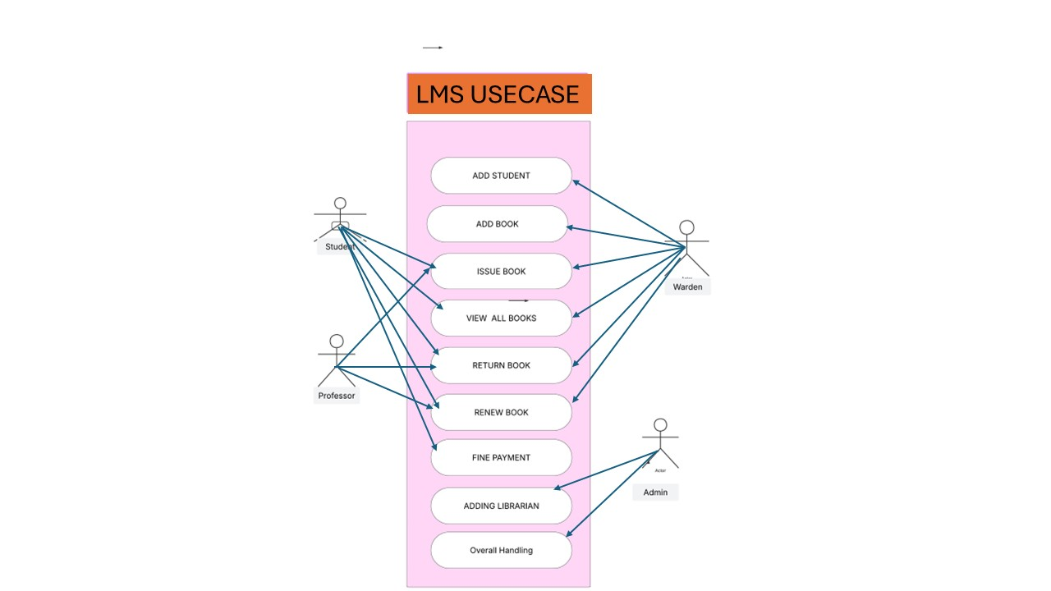
VISUAL REPRESENTATION OF MY PROJECT

Slide 3
TECHNOLOGIES USED IN THIS LMS :
JAVAFX
XML
JAVA APPLICATION API’S
SQL
ide

Slide 4
FEATURES OF JAVAFX :
HIGHLY INTERACTIVE
PROPER WORKING
2-TIER ARCHITECTURE
ATTRACTIVE VISUALS
EVENT HANDLING

Slide 5
LAYOUT PANES USED ARE :
STACKPANE
GRIDPANE
PANE
HBOX
VBOX

Slide 6
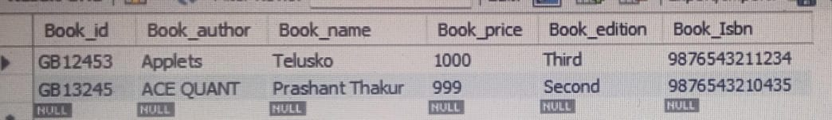
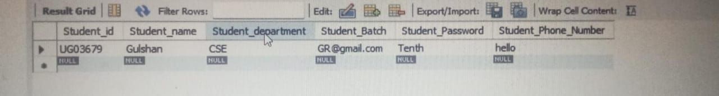
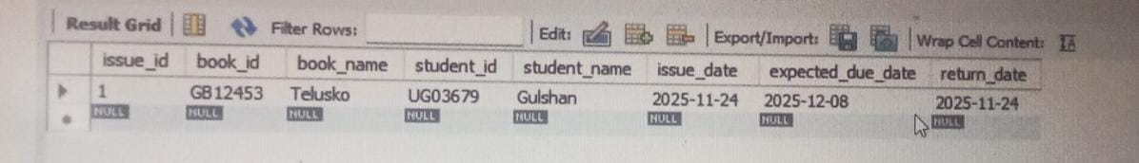
DATABASE CONNECTIVITY
BOOK DETAILS
STUDENT_DETAILS
ISSUAL-RETURN TABLE

Slide 7
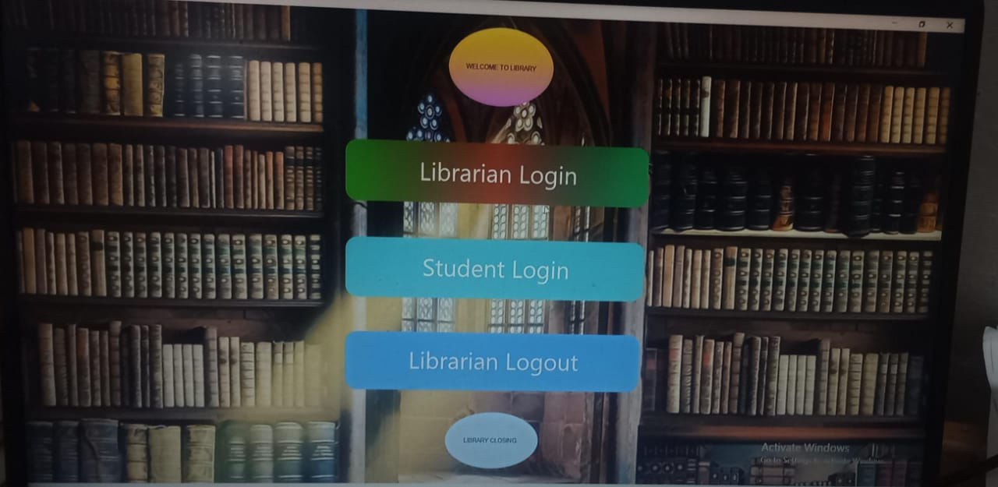
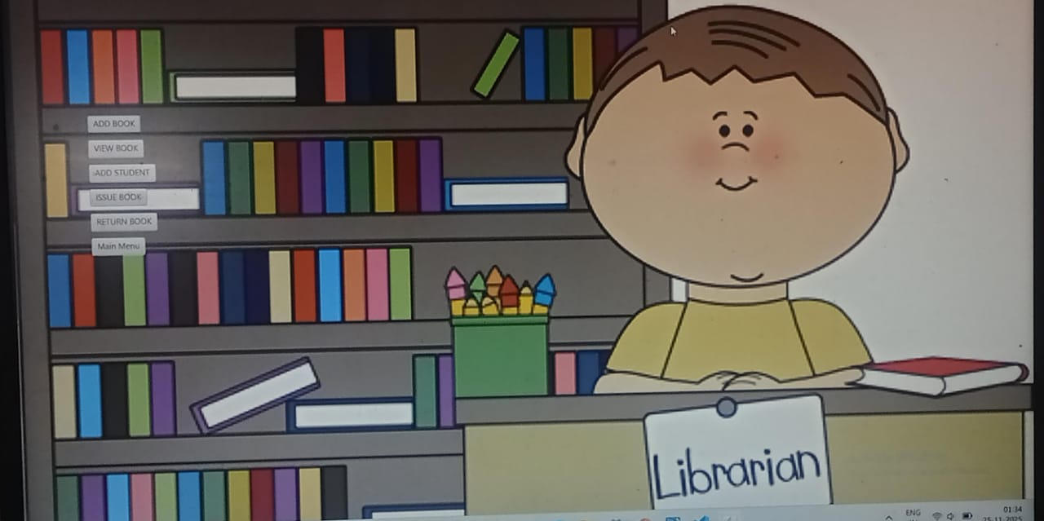
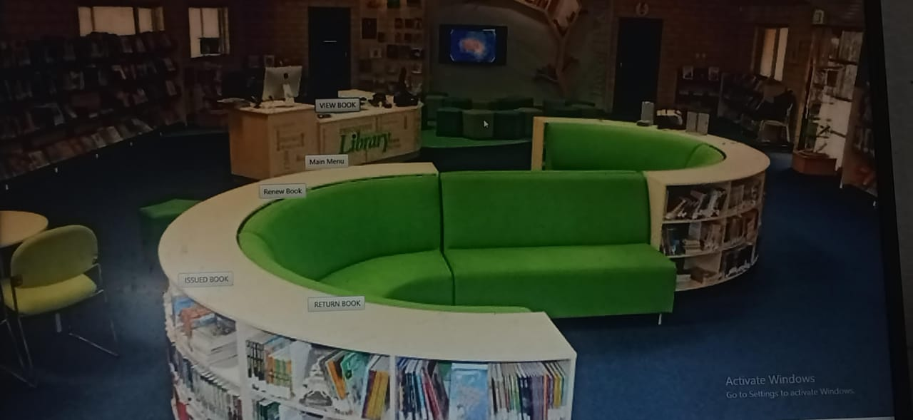
Dashboard for quick stats
MAIN DASHBOARD
LIBRARIAN DASHBOARD
STUDENT DASHBOARD
This provides features of Libraraian Login , student login and close features
This includes add student , book ,view book , issue book ,renew book and manage any updates
Issue book , renew book , return book and view all books

Slide 8
conclusion
Future development to make ux more interactive
Inclusion of ai in the system
Development of fast and rapid tech to save student’s time
Qr code for login and logout

